Slide 1
Trials for first 90 days of year
*Need to change dates on x-axis

Slide 2
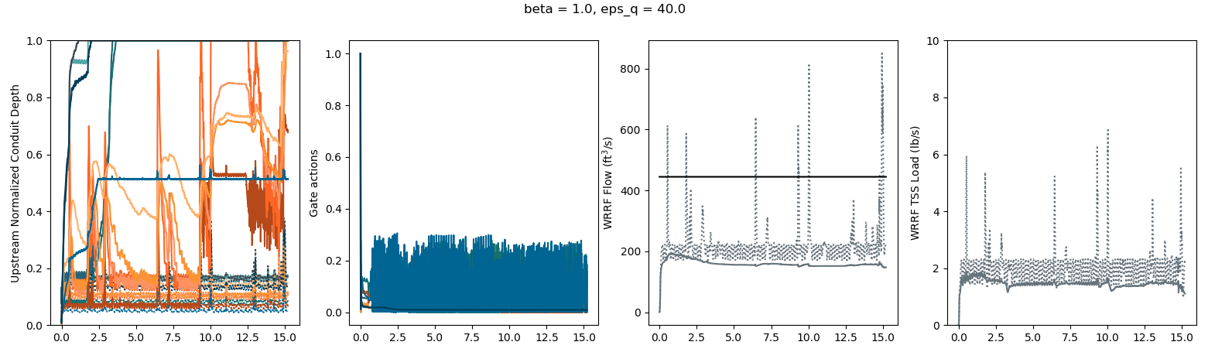
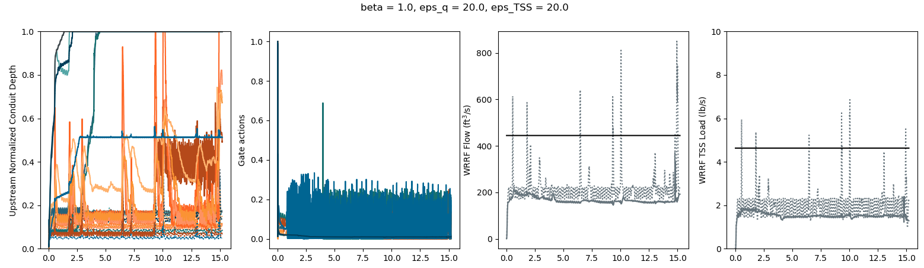
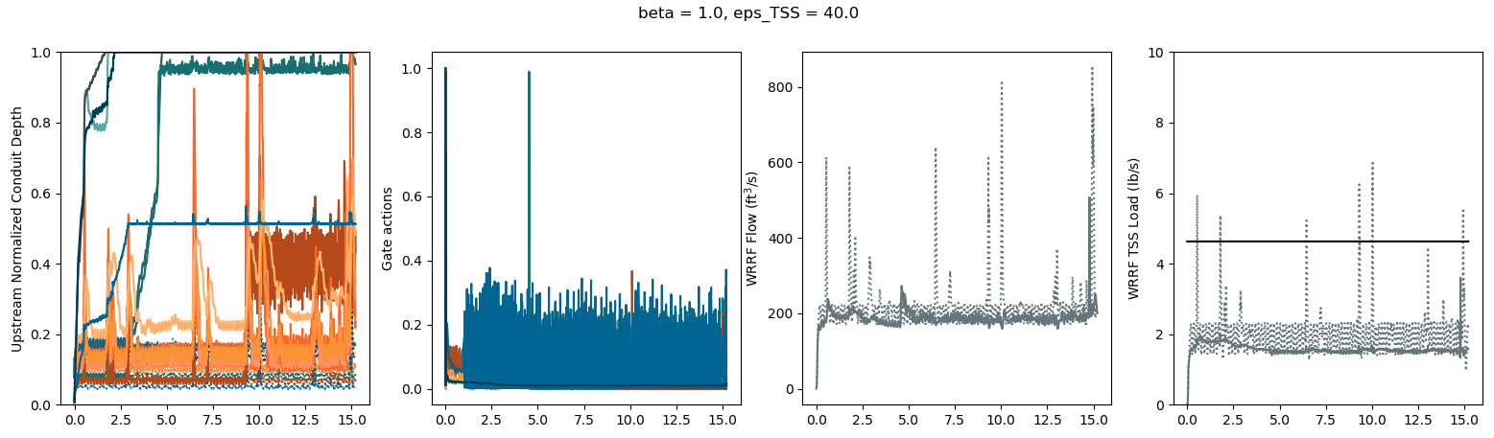
both_91: eps_q = 20., eps_TSS = 20.
flow_11: eps_q = 40.
TSS_11: eps_TSS = 40.

Slide 3
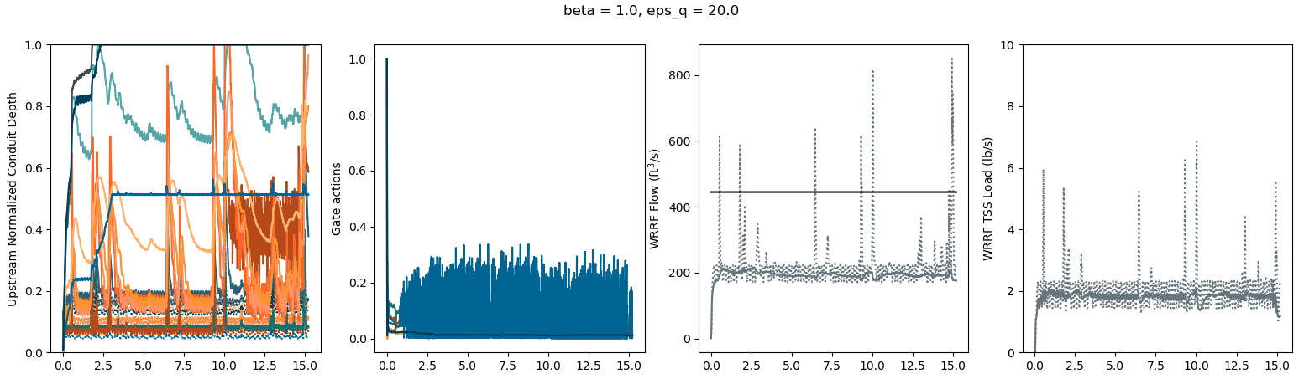
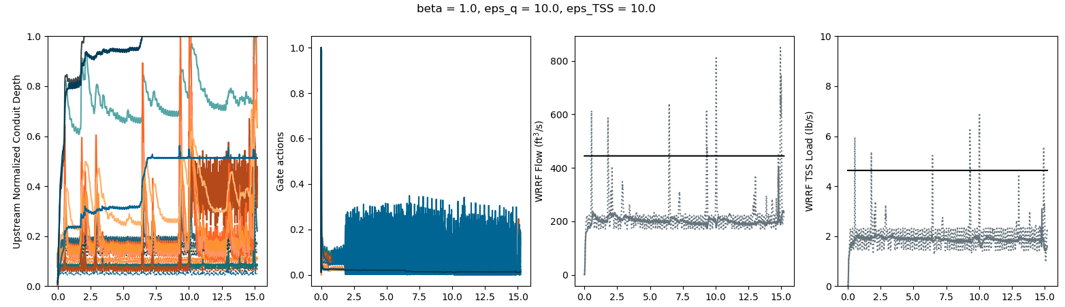
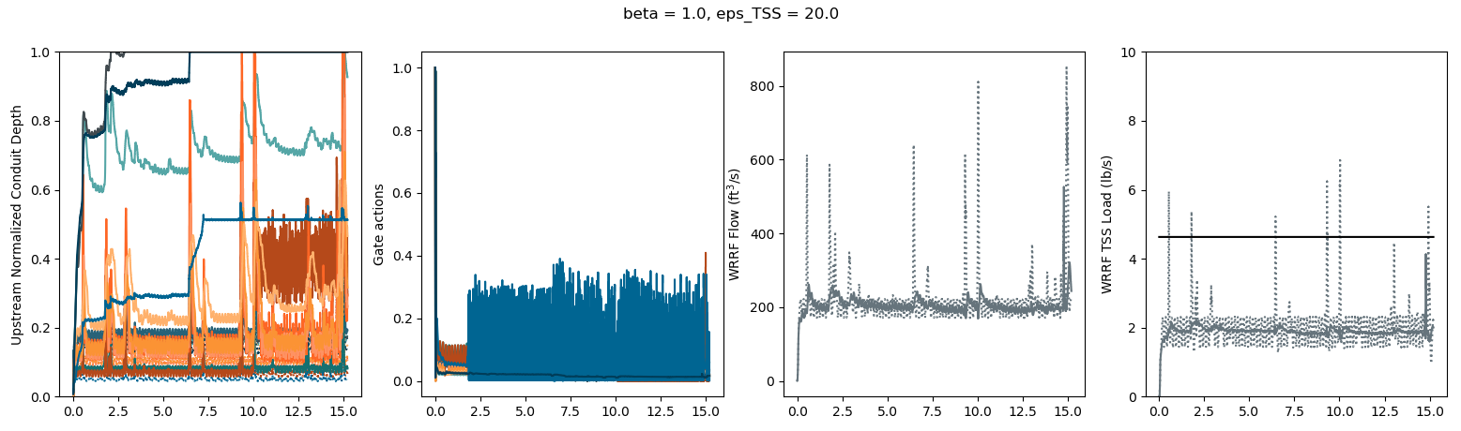
both_61: eps_q = 10., eps_TSS = 10.
flow_7: eps_q = 20.
TSS_7: eps_TSS = 20.

Slide 4
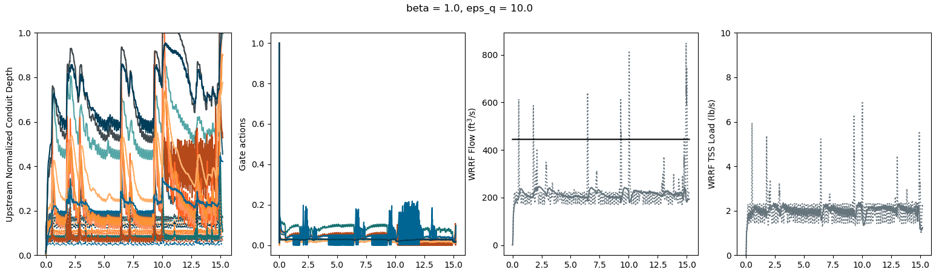
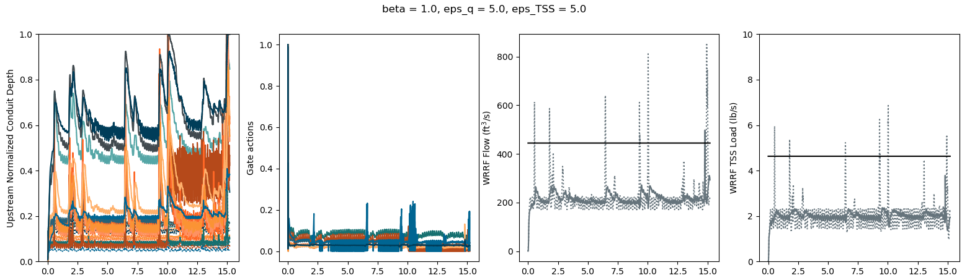
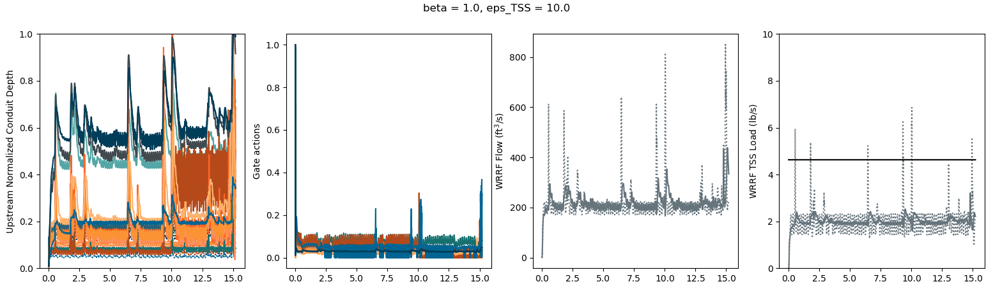
both_31: eps_q = 5., eps_TSS = 5.
flow_5: eps_q = 10.
TSS_5: eps_TSS = 10.

Slide 5
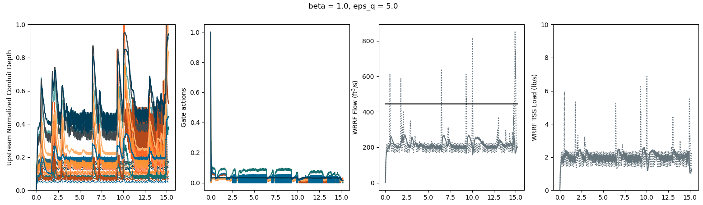
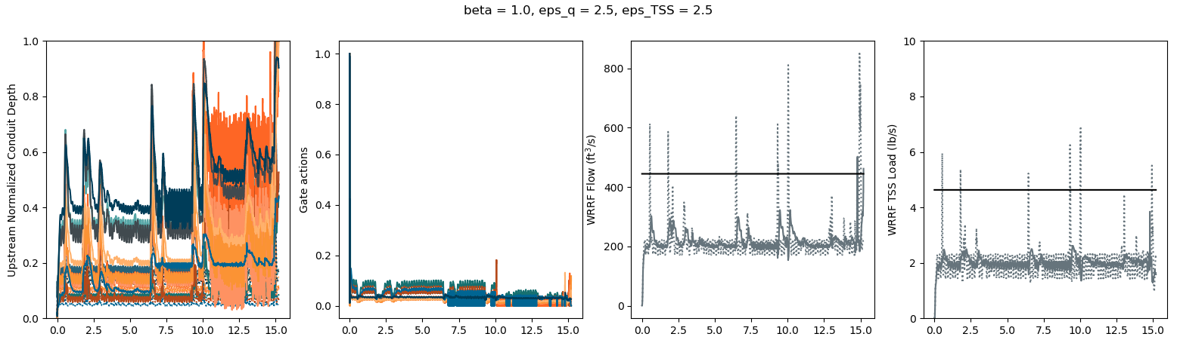
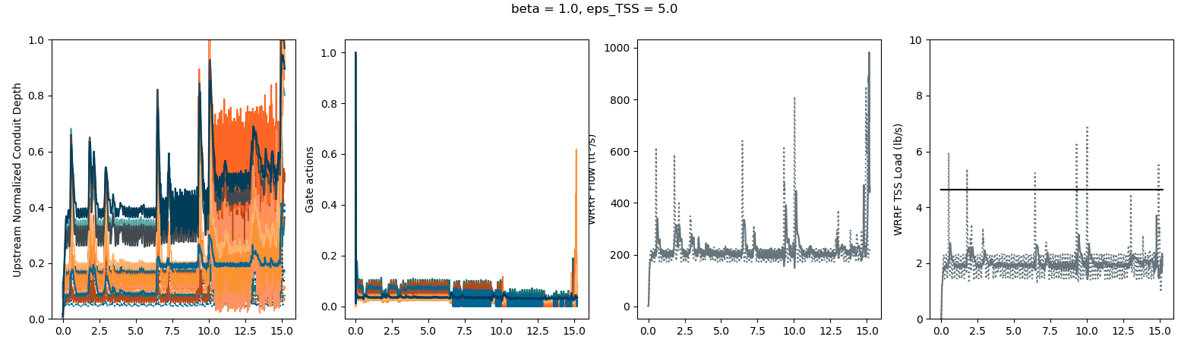
both_16: eps_q = 2.5, eps_TSS = 2.5
flow_3: eps_q = 5.
TSS_3: eps_TSS = 5.

Slide 6
Trials for days 60—150 days of year

Slide 7
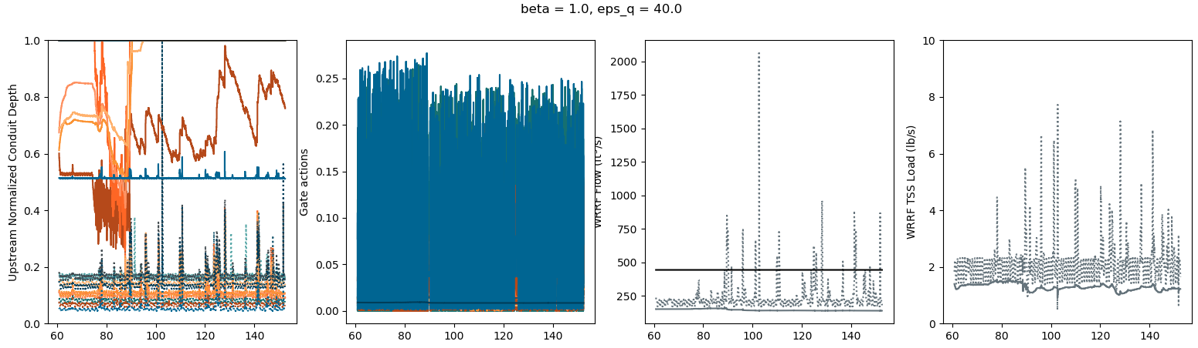
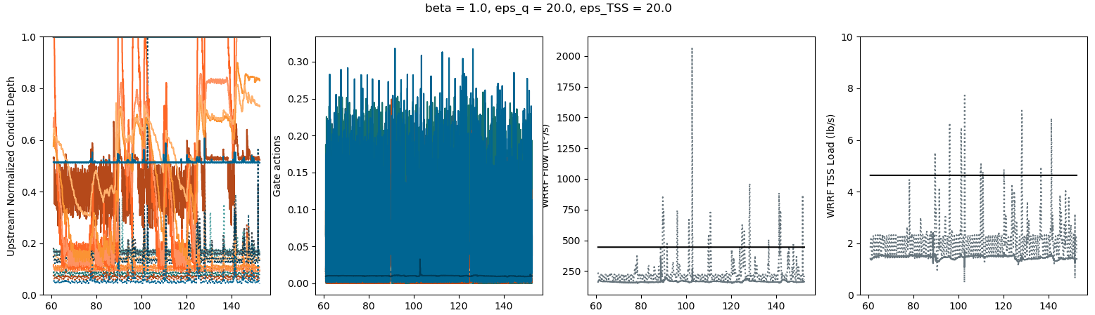
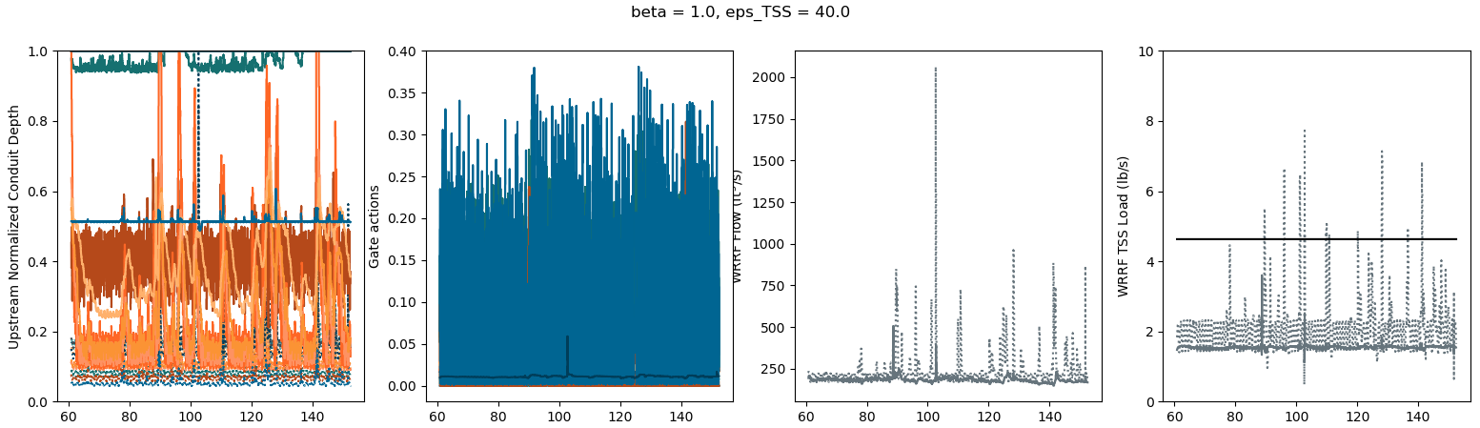
both_91: eps_q = 20., eps_TSS = 20.
flow_11: eps_q = 40.
TSS_11: eps_TSS = 40.

Slide 8
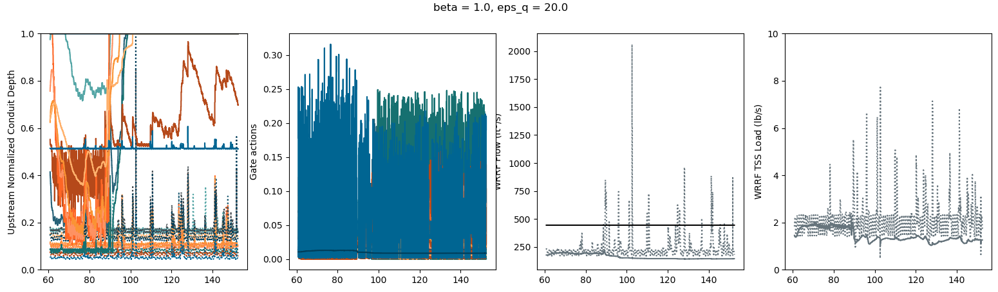
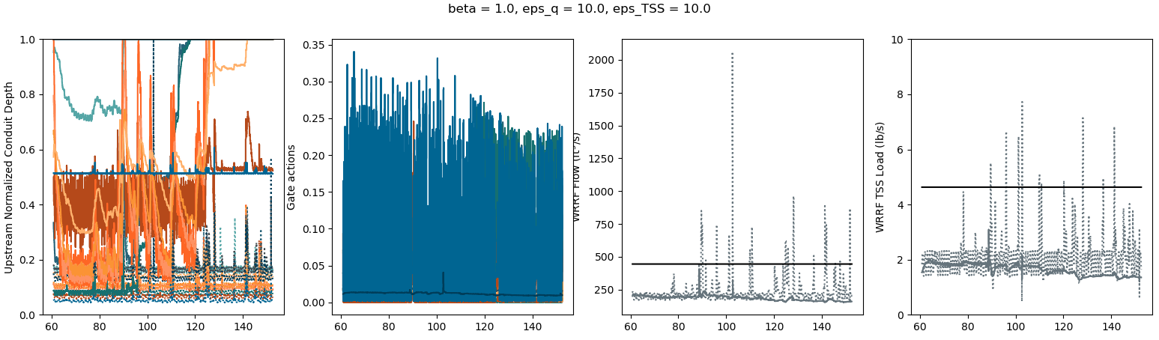
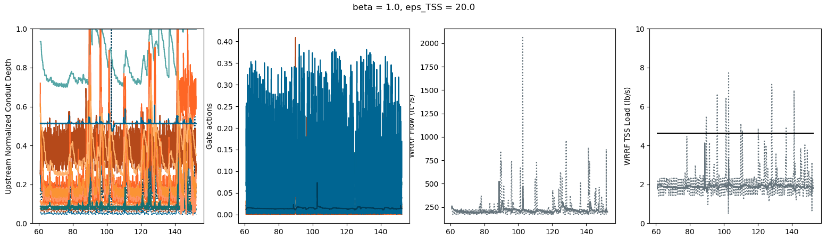
both_61: eps_q = 10., eps_TSS = 10.
flow_7: eps_q = 20.
TSS_7: eps_TSS = 20.

Slide 9
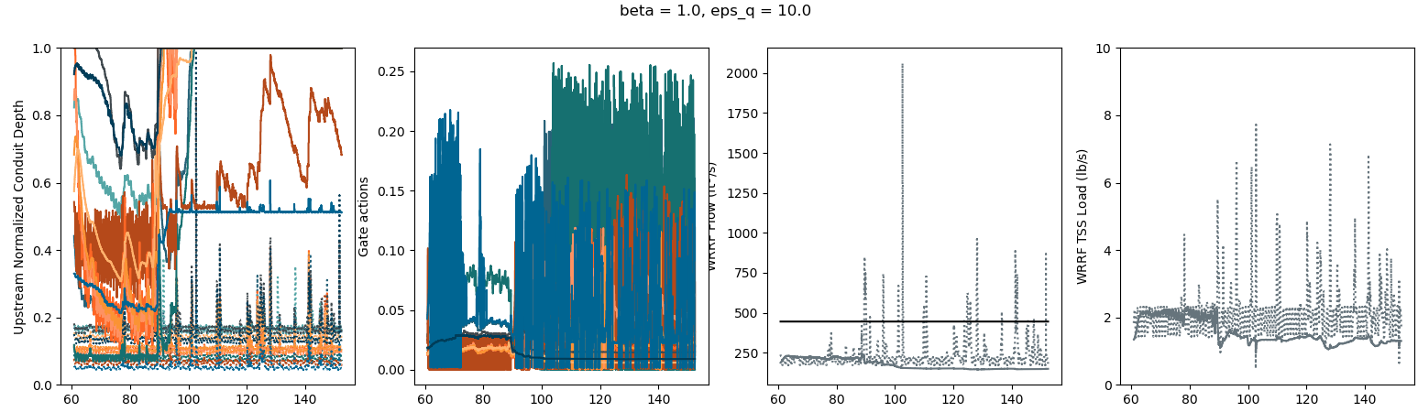
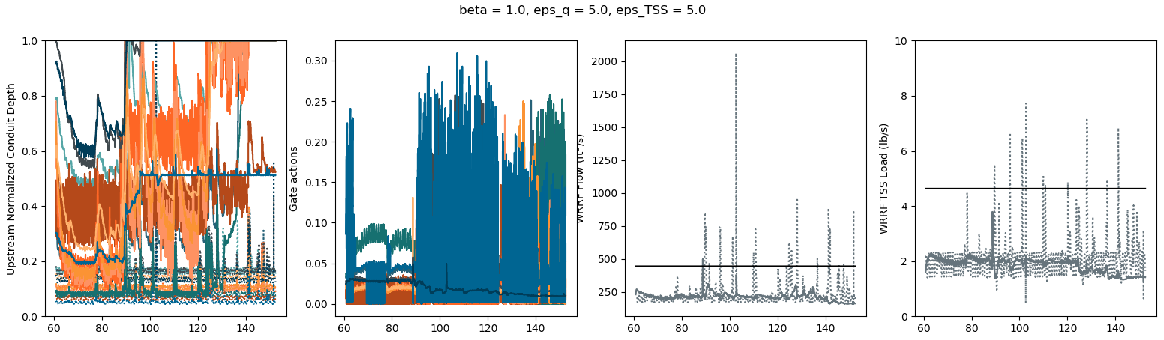
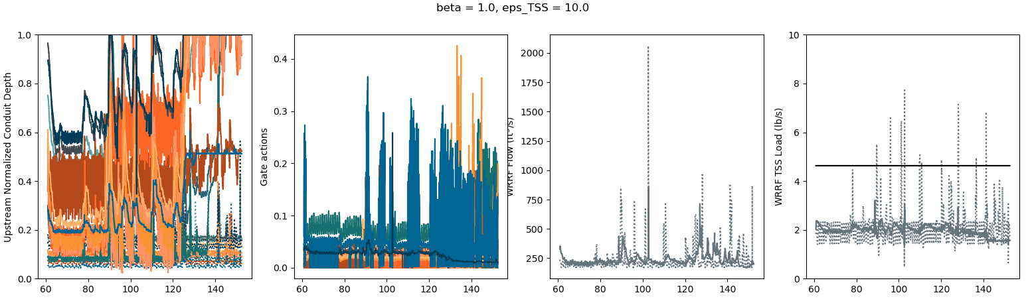
both_31: eps_q = 5., eps_TSS = 5.
flow_5: eps_q = 10.
TSS_5: eps_TSS = 10.

Slide 10
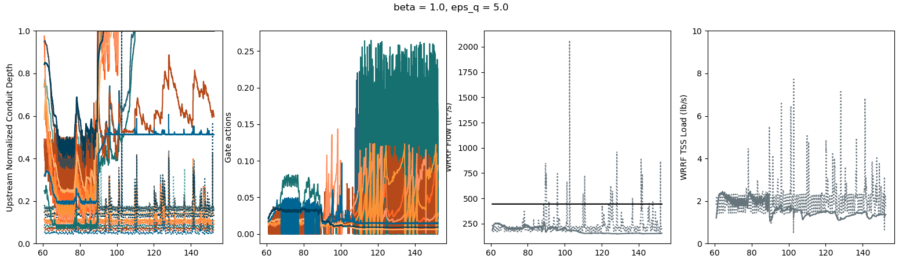
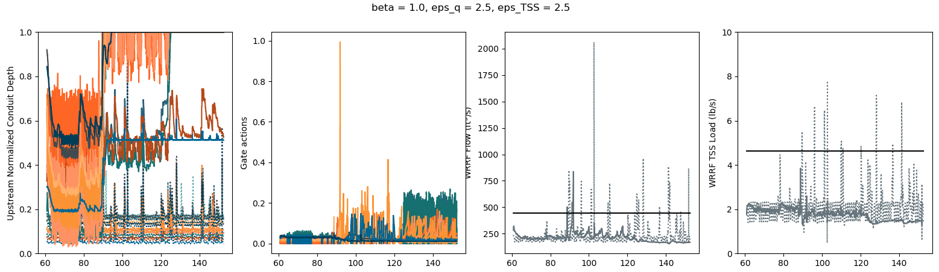
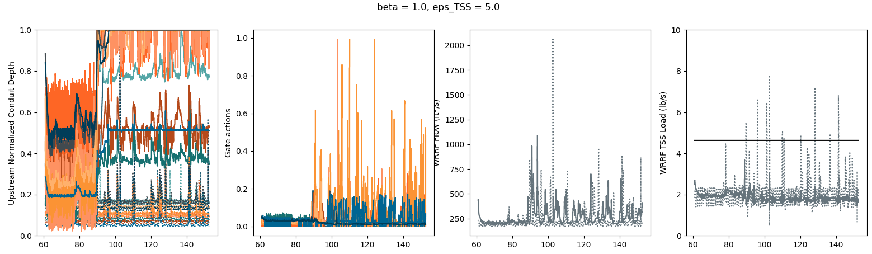
both_16: eps_q = 2.5, eps_TSS = 2.5
flow_3: eps_q = 5.
TSS_3: eps_TSS = 5.

Slide 11
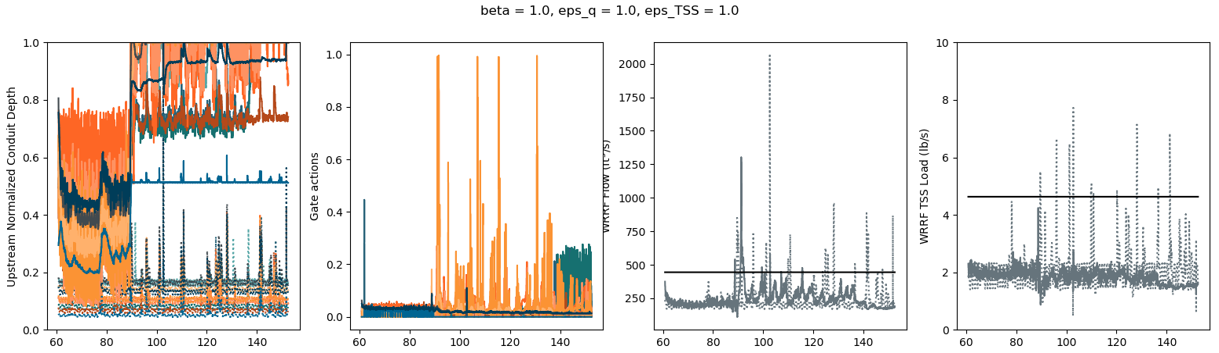
both_1: eps_q = 1., eps_TSS = 1.

Slide 12
These results are kinda of concerning
Note: previous results were only controlled every 90 min
Rerunning for 150 days, controlling every 15 min for eps_q, epq_TSS = [1., 2.5, 5., 7.5, 10.]

Slide 13
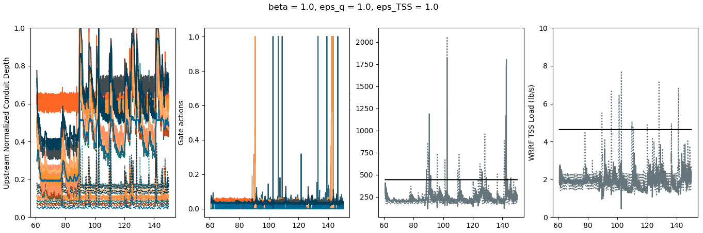
both_1: eps_q = 1., eps_TSS = 1.

Slide 14
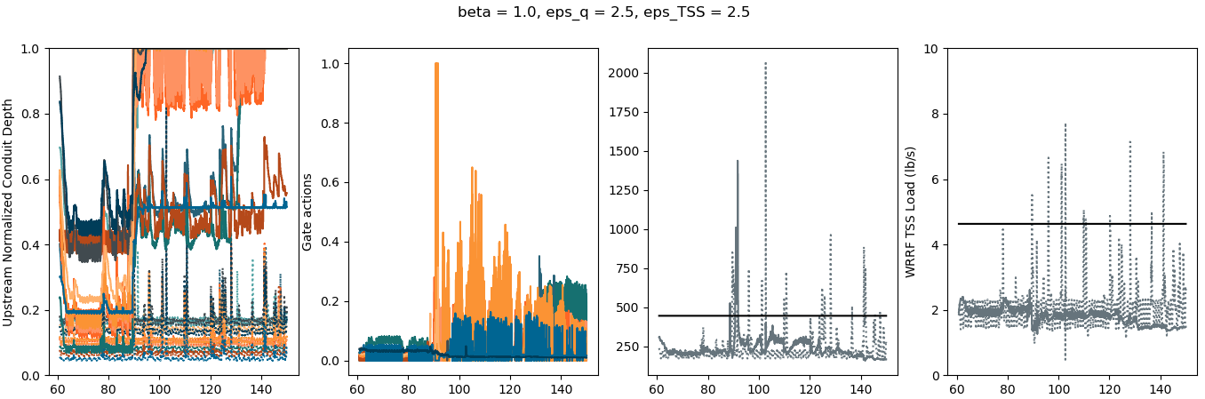
both_2: eps_q = 2.5, eps_TSS = 2.5

Slide 15
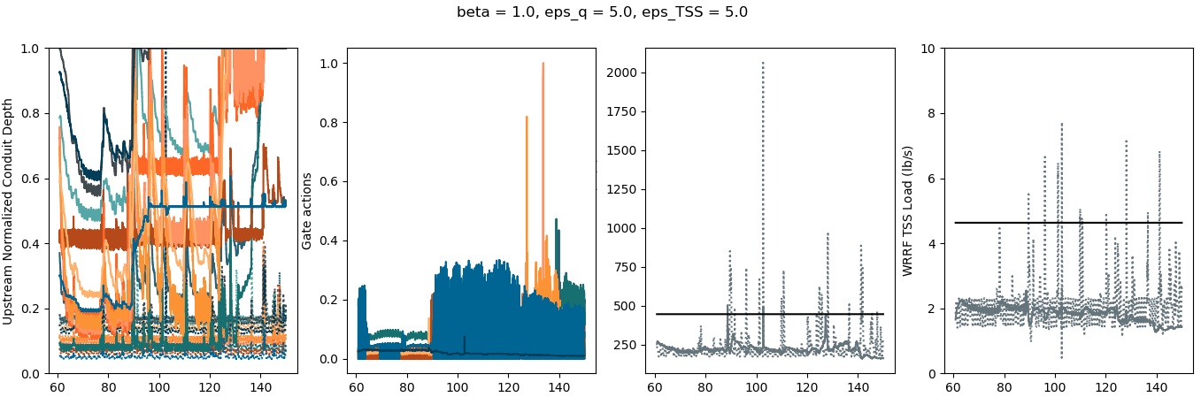
both_3: eps_q = 5., eps_TSS = 5.

Slide 16
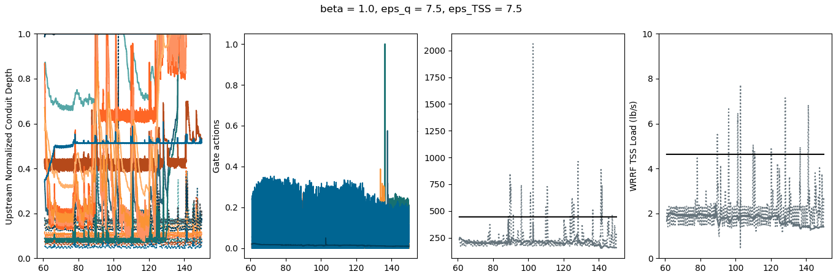
both_4: eps_q = 7.5, eps_TSS = 7.5

Slide 17
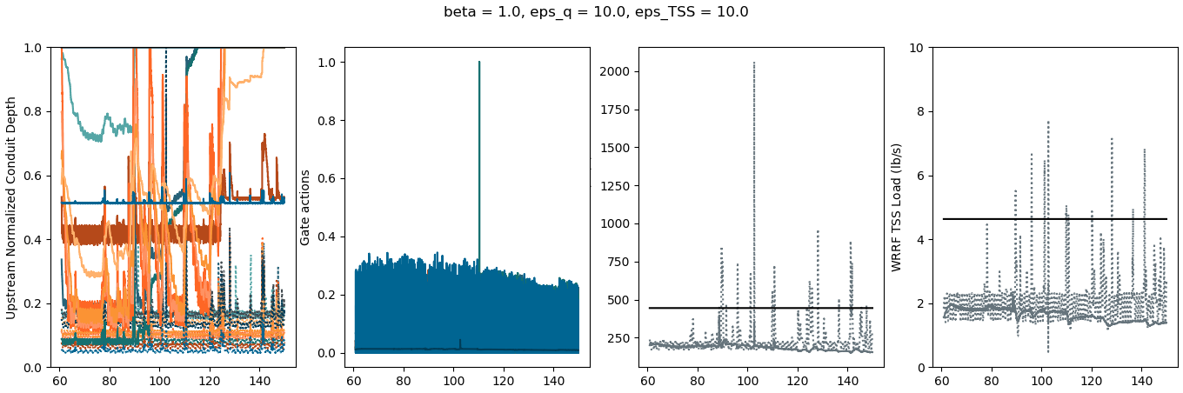
both_5: eps_q = 10., eps_TSS = 10.

Slide 18
Rerunning for 150 days, controlling every 15 min for eps_q, epq_TSS = [1., 2.5, 5., 7.5, 10.] and increasing setpt for both flow and TSS to 2.5

Slide 19
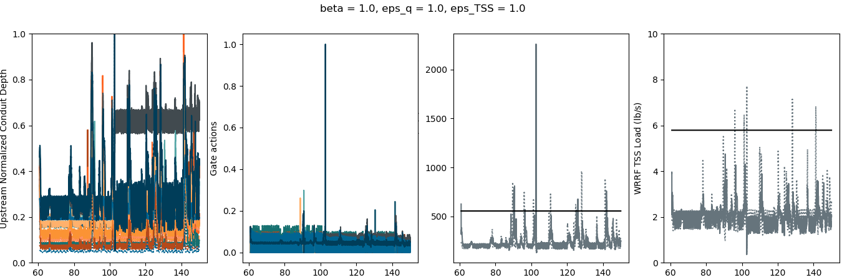
both_1: eps_q = 1., eps_TSS = 1.

Slide 20
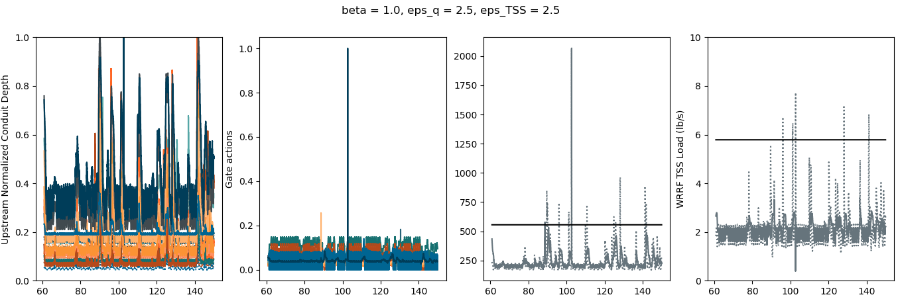
both_2: eps_q = 2.5, eps_TSS = 2.5

Slide 21
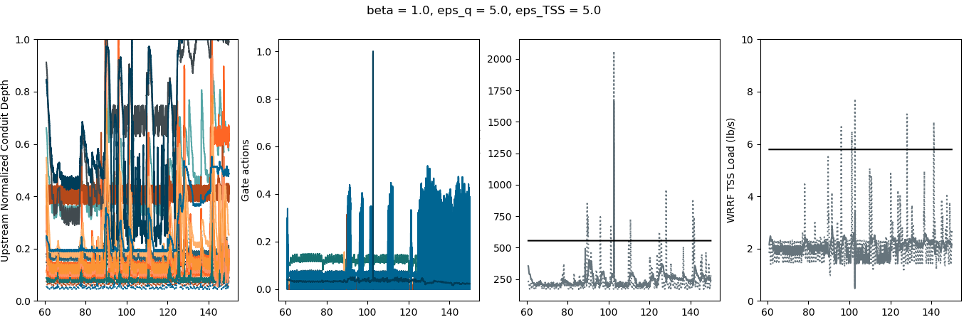
both_3: eps_q = 5., eps_TSS = 5.

Slide 22
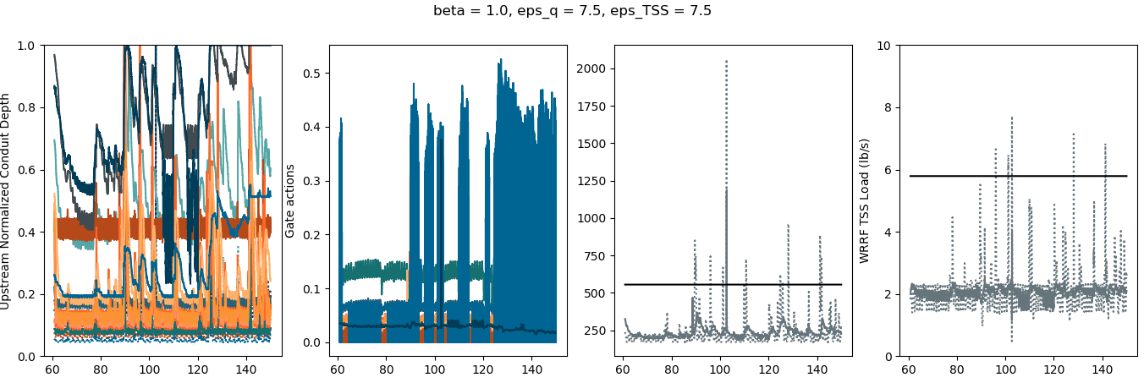
both_4: eps_q = 7.5, eps_TSS = 7.5

Slide 23
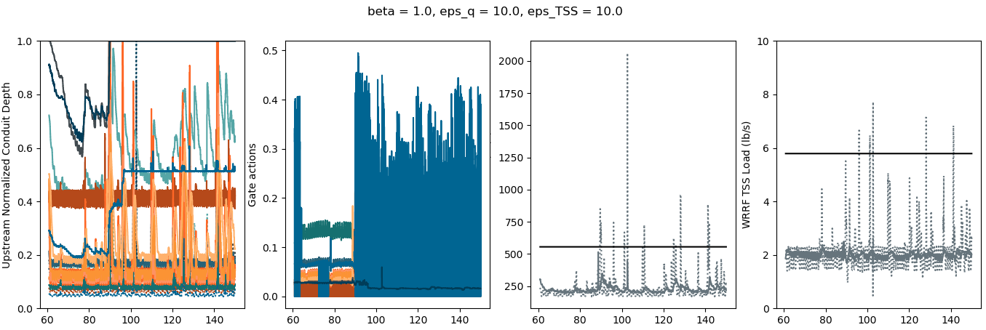
both_5: eps_q = 10., eps_TSS = 10.

Slide 24
Rerunning for 150 days, controlling every 15 min for eps_q, epq_TSS = [1., 2.5, 5., 7.5, 10.] and increasing setpt for both flow and TSS to 3.

Slide 25
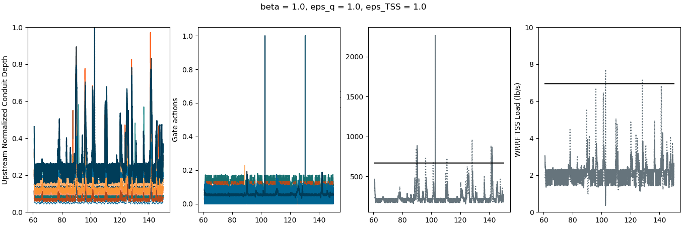
both_1: eps_q = 1., eps_TSS = 1.

Slide 26
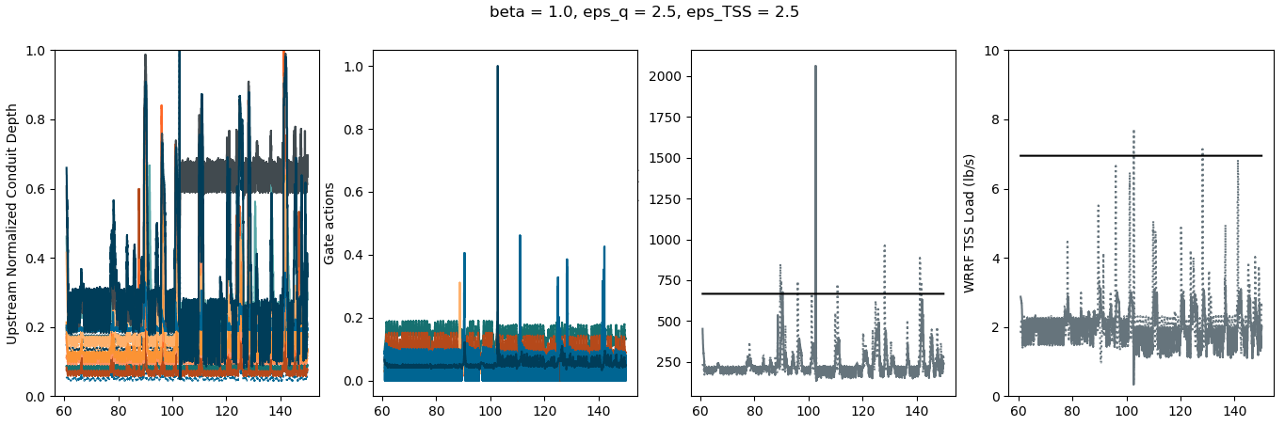
both_2: eps_q = 2.5, eps_TSS = 2.5

Slide 27
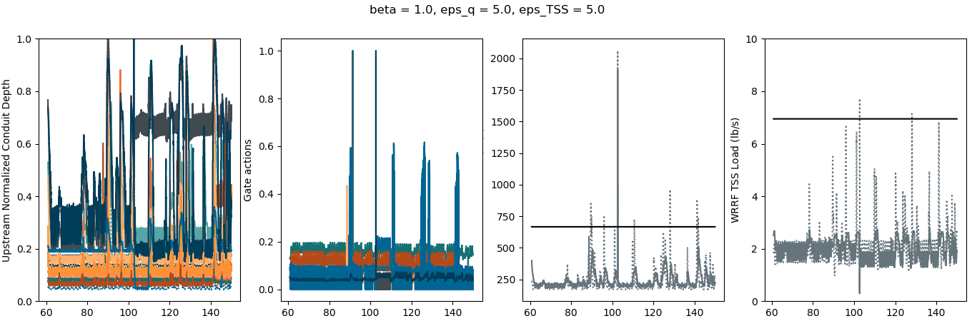
both_3: eps_q = 5., eps_TSS = 5.

Slide 28
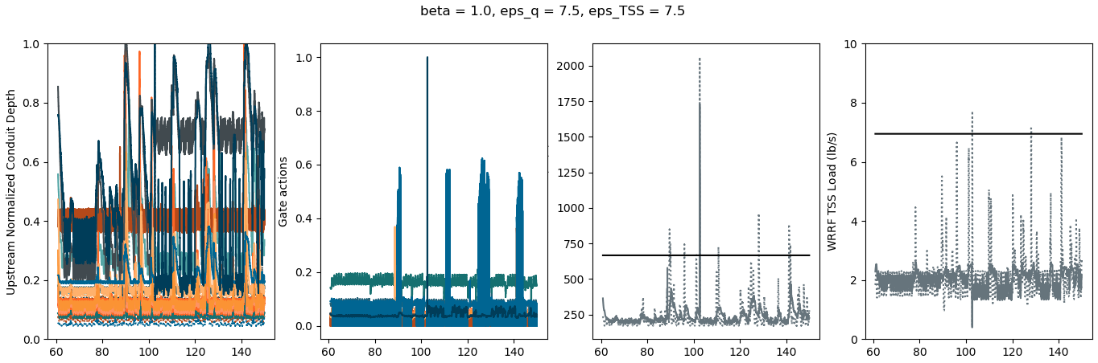
both_4: eps_q = 7.5, eps_TSS = 7.5

Slide 29
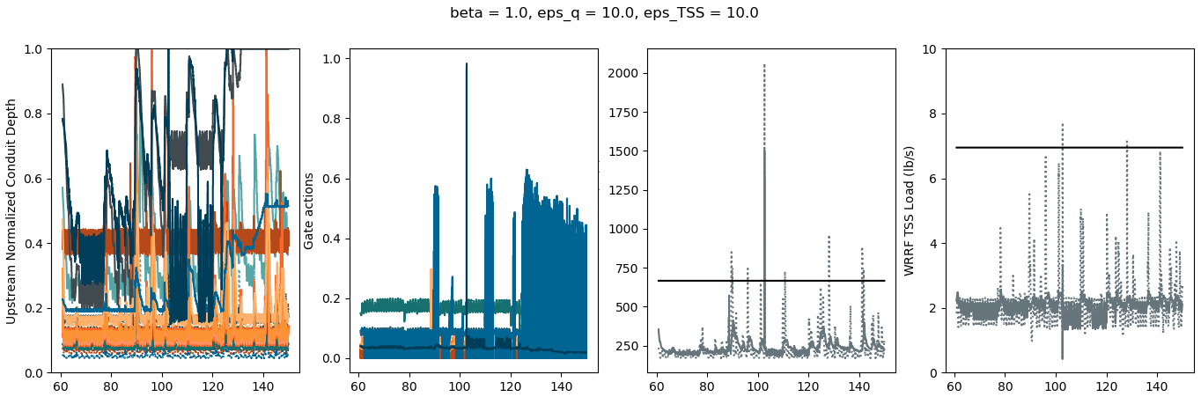
both_5: eps_q = 10., eps_TSS = 10.

Slide 30
Going to stick with 2.5 as setpoint and run for 150 days:
both: eps_q, eps_TSS = [1., 2.5, 5., 7.5, 10.] (zip)
flow: eps_q = [2., 5., 10., 15., 20.]
TSS: eps_TSS = [2., 5., 10., 15., 20.]

Slide 31
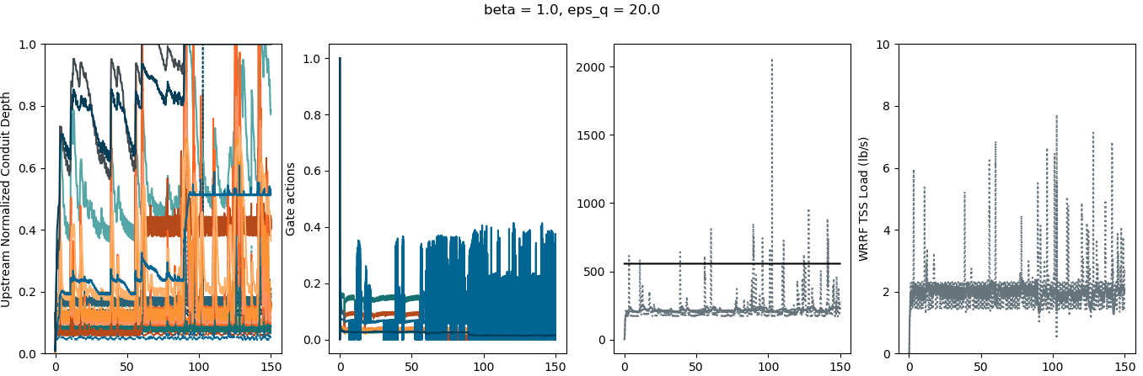
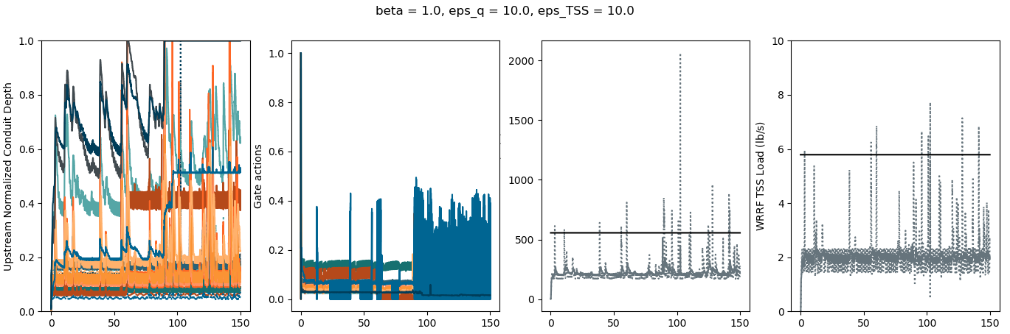
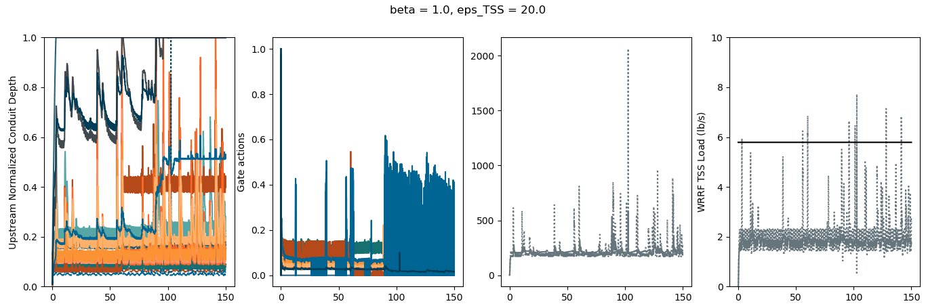
both_XX,
eps_q = 10., eps_TSS = 10.
flow_XX, eps_q = 20.
TSS_XX, eps_TSS = 20.

Slide 32
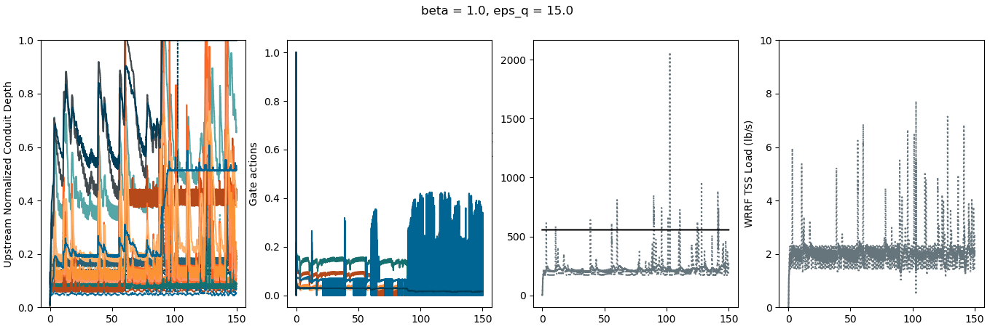
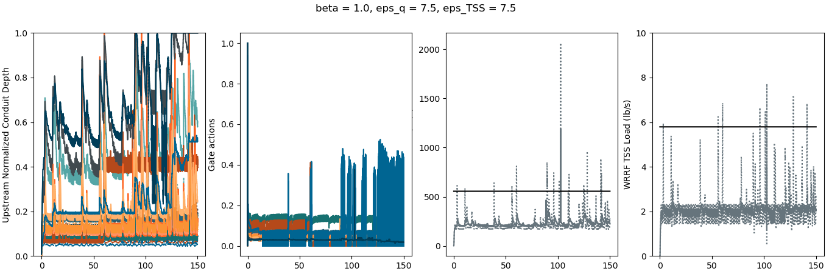
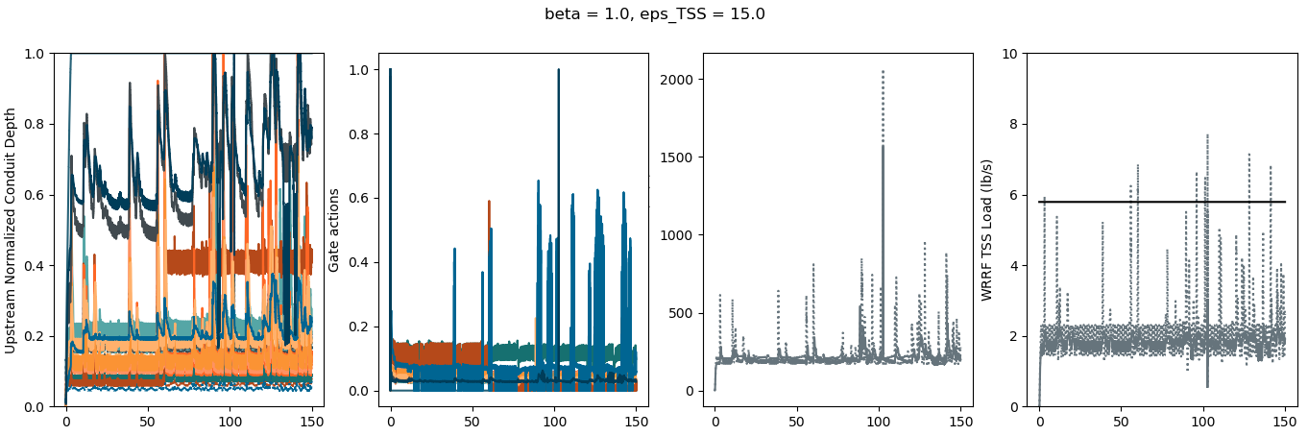
both_XX,
eps_q = 7.5, eps_TSS = 7.5
flow_XX, eps_q = 15.
TSS_XX, eps_TSS = 15.

Slide 33
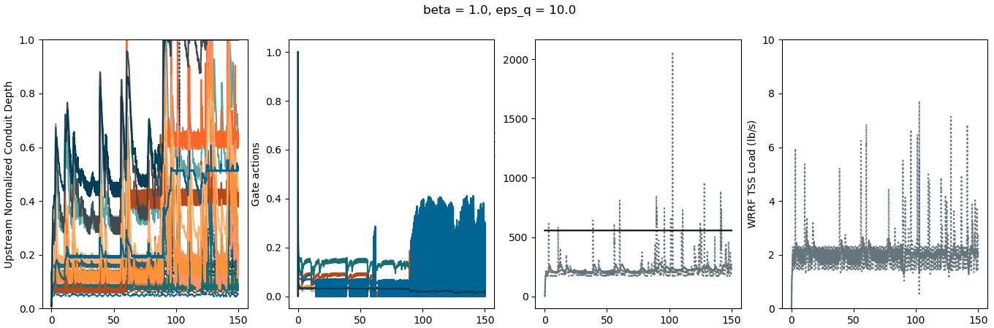
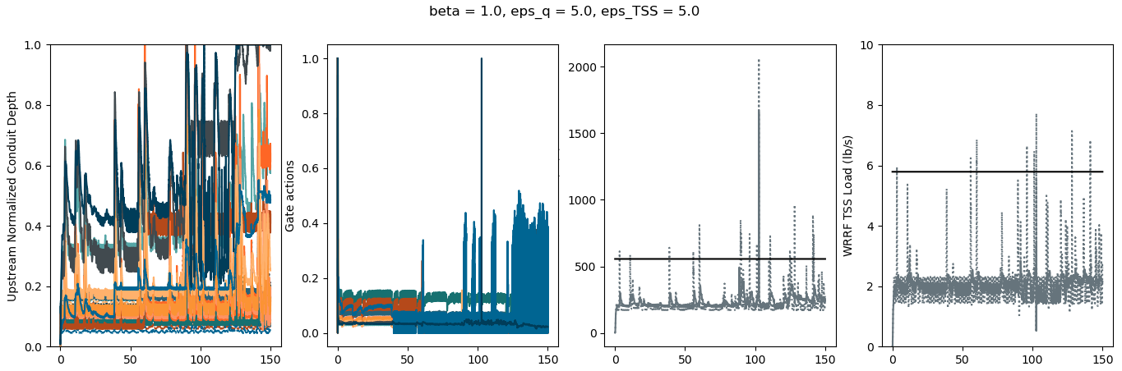
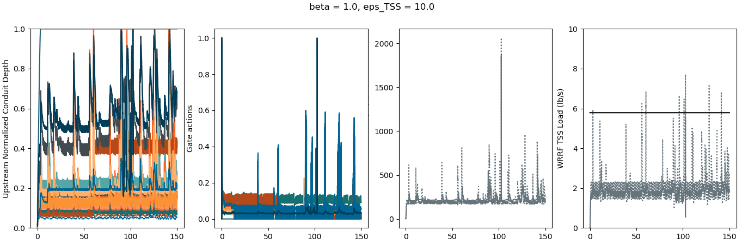
both_XX,
eps_q = 5., eps_TSS = 5.
flow_XX, eps_q = 10.
TSS_XX, eps_TSS = 10.

Slide 34
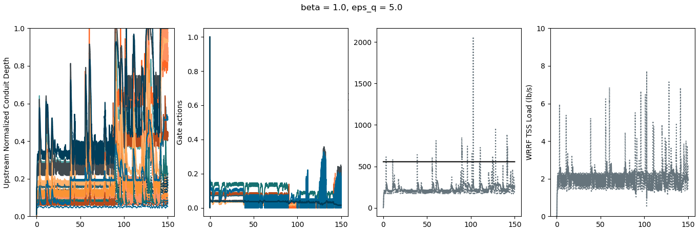


both_XX,
eps_q = 2.5, eps_TSS = 2.5
flow_XX, eps_q = 5.
TSS_XX, eps_TSS = 5.

Slide 35



both_XX,
eps_q = 1., eps_TSS = 1.
flow_XX, eps_q = 2.
TSS_XX, eps_TSS = 2.

Slide 36



